Slide 1
Economics of the Household
Most Households in LDCs earn part of livelihood in their own enterprises (often farms). They consume part of their production, use their own labor but may also purchase some inputs and sell some of their output.
They make decisions about production, (level of output, factor demand, choice of technology) and consumption simultaneously

Slide 2
For Agric. HH with two members (1,2): When Markets Are Complete
Max U (c₁, c₂, l₁, l₂) (1)
Subject to:
p(c₁+c₂)+wL^{h}+rA^{h}<= F(L,A)+w (L^{m}₁ + L^{m}₂) +rA^{m} (2)
L= L^{f}₁ +L^{f}₂ +L^{h} (3)
A = A^{f} + A^{h} (4)
E^{A}= A^{f}+A^{m} ; E^{L}_{i} = L^{f}_{i} +L^{m}_{i} +l_{i}, i€{1,2} (5)
c_{i}, l_{i}, L^{f}_{i}, L^{m}_{i},A^{f},A^{m} ≥ 0, i€{1,2} (6)
c =cons, l = leisure, L= labor, A= land, m=market, h=household, f = used on family farm

Slide 3
Substituting (3)-(5) into (2) yields: p(c₁+c₂)+w(l₁+l₂)≤Π+w(E^{L}₁+E^{L}₂)+rE^{A} (7)
(Full Income Constraint)
RHS of (7) is Profits plus market value of endowment
Π = F(L,A) –wL –rA (8) c_{i}, l_{i}, L^{f}_{i}, L,A ≥ 0, i€{1,2} (9)
If (1) is not satiated, then p(c₁+c₂)+w(l₁+l₂)≤Π*(w,r) +w(E^{L}₁+E^{L}₂)+rE^{A} (7’) where Π*(w,r) = Max F(L,A) –wL-rA (8’)
Hence, the problem simplifies solving (8’) and then the rest. Production (8’) and consumption (1’) decisions are separated, (8’) first, then (1)

Slide 4
Without a Land Market
A= E^{A} and r =0
The same separation would hold with HH choosing only l to Max farm profits and from that consumption and leisure can be solved for

Slide 5
Further Assumption
A single household member, or that they are identical, then we can see how this works: Figure 2.1
Perfect Market assumption is reflected in the straight line slope .
HH chooses L* of own or hired labor and then once Π* is determined can solve for c, l

Slide 6
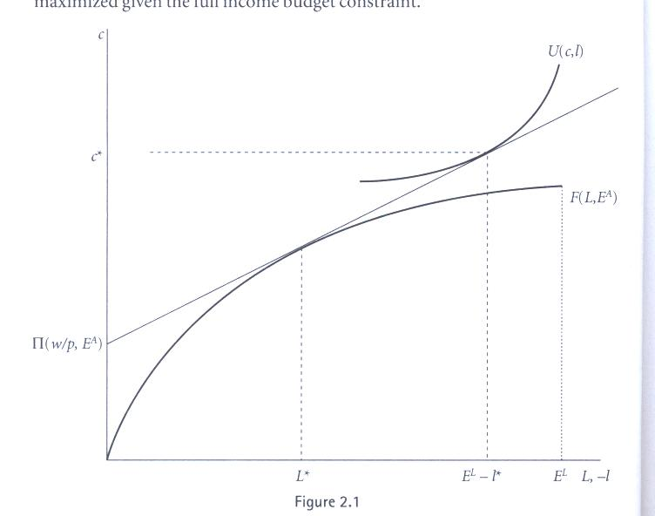

Slide 7
Similar Result and property
If land market existed
But Labor Market did not
SOME OTHER CONSIDERATIONS

Slide 8
But in context with no rental and poor off-farm labor market
Bulgaria after transition, where property rights in land very uncertain due to uncertainty about aftermath of restitution
Agricultural product markets very constrained due to the absence of marketing and middle men
Deterioration of off-farm labor markets with privatization, bankruptcies, depression
Bhaumik, Dimova and Nugent show that separability does not hold in Bulgaria, especially in crisis year 1997

Slide 9
Next more realistically assume Incomplete Markets for Land and Labor (w/o Land Market)
Still assume a single household member. w
Max U (c, l) (1)
(c,l,L^{H},L^{F} ≥ 0)
pc+wL^{h} <= F(L^{f} +L^{h}, E^{A})+w L^{m} (2)
l +L^{f} +L^{m} = E^{L} (3)
L^{m} ≤ M (4)
If (4) is not binding, the labor market is sufficiently perfect that there is only one incomplete (i.e., missing) market, that for land. Thus (2) becomes
pc +wl = F(L,E^{A}) –wL + wE^{L}
So, separation holds, production decision made first, followed by the utility-maximizing ones for c,l, L^{h}, L^{f}, L^{m}

Slide 10
But if (4) for M is Binding
L^{m}=M, L^{h}=0; so (1) is maximized with respect only to c,l and (2) reduces to:
c= F(E^{L}-M-l,E^{A}) +wM (2’)
FOC: U_{l}/U_{c} = F_{L} (3’)
Figure 2.2 from Benjamin (1992) illustrates this: Outer axes measure c and time endowment less leisure, Inner ones output and labor on farm
The consumption and production decisions are now made simultaneously

Slide 11
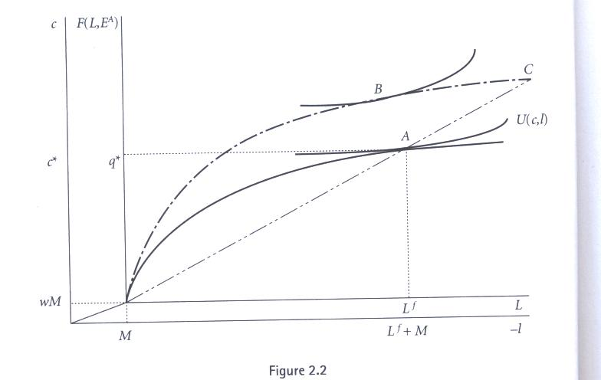

Slide 12
Explanation of negative relation between farm size and labor productivity or intensity of cultivation
See Figure 2.2 for farm of larger size. It maximizes with labor less at point B rather than at pt. C as would be if it used same labor intensity as for the smaller farm. Income and consumption are higher for the large firm because of the extra land.

Slide 13
Alternatively with perfect labor market but where production is risky, HHs are risk- averse and insurance market is non-existent
Max EU (c) (1)
(I≥0)
s.t. c= ΘE^{A} f (L/E^{A}) –wL +wE^{L} (2)
Where E Θ = 1
FOC: EU’ ( c ) [Θf’(L/ E^{A}) – w] = 0 (3)
This can be re-expressed as:
f’E ΘU’ =wEU’ where U’=U’( c ) and f’=f’(L/E^{A})
f’cov(U’, Θ) = (w- f’) EU’
- ? + implies (w-f’) = -
This too gives a inverse relation between farm size and cultivation intensity. Hence, an empirical finding of this sort does not identify the source of the imperfection or incompleteness.

Slide 14
But, when Involuntary unemployment exists
Equation [13] binds (L_{m} = M) as when E^{A} is small relative to E^{L}
Implication
[14] Max U(c, l)
Subject to
[15] c = F(E_{L} - M – l, E^{A}) + wM, i.e., L_{h} = 0
Constrained optimisation
  first order conditions (15) and U_{l} / U_{c} =F_{L}
  Optimal level of c and l jointly determined
    Separation principle no longer holds

Slide 15
When Involuntary unemployment does not exist
Equation [13] is not binding (L_{m} < M), i.e., supply of family labor to the market is not constrained by the ceiling on available jobs
Implication
[13’] pc + wl = F(L, E_{A}) – wL + wE_{L}
when
L ≡ amount of labor used on the farm
Separation principle holds
  If farms have constant returns to scale technology, all farms facing the same wage would employ the same number of people
    Labor demand function: w = f’(L/E_{A})
  Each farm would have the same yield per hectare as well as the same output per laborer

Slide 16
Other Market Incompleteness of Failures
Risk in Production with no insurance
Max EU(c )
S.T. c=θEA f((L/E^{A} ) –wL+wE^{L}
Θ is random variable positive with mean of 1
Separation does not hold
EU’ (c ) [θf’ (L/E^{A )} –w =0
This also gives inverse relation between farm size and land productivity
Product market is also incomplete or non-existent
Or hh produces only home goods like children

Slide 17
Extensions
Strauss and Thomas Introducing health H andL^{C}
Max U(c, H, l) (1)
(c,l,L,L^{C})
pc +wl +wL^{C} = F(L)- wL –wE^{L} (2)
H= H(c,L^{C} ) (3)
L^{C} is labor producing health
(2) Implies that separation property holds wrt production on farm, but (3) involves preferences
FOC: δH/δL^{C =} wλ(δ U/ δH)⁻¹

Slide 18
Intrahousehold Decision-Making
Thomas findings that child health responds more to woman’s non-labor income than to man’s
Non-unitary HH decision-making

Slide 19
Tests of Separation:Empirical evidence of Pitt and Rosenzweig (1986)
Hypothesis
  Demand for labor by farm-owing households should not be dependent on demographic characteristics of the households that embody their endowment of labor power
Data
  4117 rural households from rural Java
  64 percent of households own land
  50 percent of landed households engage in off-farm wage labor some time during the year
Result
  By and large, there is evidence supporting the separation principle. But other contexts perhaps not

Slide 20
Most Other Empirical Studies
Separation property does not hold
Kevane 1994, Udry 1998, Barrett 1996, Collier 1983 , Jacoby 1993

Slide 21
All this has assumed unitary hh
Multiple people with transferable utility . If this is so hh aggregate demand is not influenced by distribution of utility within hh and aggregate choices would be consistent with that of single individual who controls hh income
If hh consumes only private goods and members have identical preferences this Pareto efficient equilibrium could be achieved by competitive equilibrium within the hh

Slide 22
Should we be content with the unitary household model?
Unitary household model
  Can we assume that the decisions of household can be replicated by that of a single individual?
    Only if utility is transferable freely across hh members
Testable hypothesis
  Ceteris paribus, a household’s demand and supply should only be affected by the overall income of the household
Empirical evidence
  This is typically not the case
  For example, children typically do better in households where their mothers have control over a large proportion of household resources and this may be when they have brought greater wealth to marriage or work and keep their earnings separate

Slide 23
Non-farm labor market [1]
Importance
  In China, growth of employment in the manufacturing sector during 1978-86 was 7.7 percent per annum
  Growth of employment at TVEs during the same period was 12.7 percent
  Share of rural employment in non-farm sector rural rose from 12 percent in 1980 to 20 percent in 1986
Problems with measuring productivity
  (Own) capital may not have high opportunity cost even if credit is relatively expensive
    Choice of technology may deviate from the optimal
  Heterogeneity of people employed in the non-farm sector on account of differences between people who have no other choice and those that are more productive in the non-farm sector than in the farm sector

Slide 24
Non-farm labor market [2]
Poverty and income distribution
  Japan: Share of non-farm income low for farm households with the highest incomes
  Botswana, Gambia, Kenya, Nigeria: An equalising effect
  India: U-shaped relationship between non-farm income and total income (or assets)
  Bukarina Faso, Java: Richest households received the largest incomes from non-farm sources
Unemployment
  Evidence from India (c. 1984) suggests that rural off-season (peak season) unemployment was 23 percent (14 percent) for men, and 42 percent (20 percent) for women
    Why does the rural non-farm wage not decline to clear the market?

Slide 25
Non-farm labor market [3]
Worker requires a minimum level of consumption to be productive. The notion of efficiency wage
This minimum level of consumption defines his reservation wage
If the reservation wage is too high, he may remain unemployed
Policy implication involves importance of non-wage income
output
c* consumption

Slide 26
Non-farm labor market [4]
Women
  In some societies women not allowed to work outside hh, or cannot because of children to care for
  Significant source of employment for women for whom working away from home is often infeasible
    Botswana, Bukarina Faso, Malawi, Zambia: Beer brewing
    Ghana, Senegal: Fish processing
    Bangladesh: Cottage industries
Diversification
  China: Most TVE workers retain right to work on agricultural land, and many work part time in farming
    Mixed evidence about correlation between farm- and (derived) non-farm income
  Kenya: Significant positive correlation between farm productivity and revenue, and non-farm income
    Mitigation of capital market failure

Slide 27
Non-farm labor market [5]
Dynamic model
  Impact of Green Revolution in India raises agricultural productivity, and hence farm income
  Either labor is released or agricultural wage goes up, resulting in lower factor cost or more capital for non-farm sector
  Both forward (need to process agricultural good) and backward (agriculturists’ demand for input) linkages with rural non-farm sector
  Consumption linkages raising demand for goods and services produced locally
  Increase in demand for non-farm goods and services results in qualitative change in the demand for agricultural products, and leads to higher investment in agricultural technology
  Empirical evidence indicates that a $1 increase in farm income usually results in a >$1 increase in non-farm income, as well as an increase in non-farm employment

Slide 28
Non-farm labor market [6]
Policy response
  Targeted credit programmes
    Grameen Bank of Bangladesh has a default rate of less than 1 percent, but it cannot cover its operations costs even after charging a 16 percent interest rate
  Removing infrastructural and logistical problems that impede marketing
  Licensing of modern sector manufacturing
    The impact of such policy on employment generation by the textiles sector in India was muted on account of the rapid spread of power looms. Putting out system
  Public works schemes
    Reduced volatility of income
    Increased wages in other sectors
    Women participation rates as high as those of men

Slide 29
Back to AHM with imperfections in labor market and no land markets
Assumptions
  Presence of involuntary unemployment, i.e. A second incomplete or imperfect market, HH is now 1 person, M is maximum opportunity to work in labor market
[10] Max U(c, l)
(c,l,L^{H},L^{F >}= 0
Subject to
[11] pc = F(L_{f} + L_{h}, E_{A}) – wL_{h} + wL_{m}
[12] l + L_{f} + L_{h} = E_{L}
[13] L_{m} < M
If not for (13), AHM would again be separable

